Slide 1
Starter Task
Solve the anagrams!
iemaj
nusay
elmsii
cherpit
dejaevict

Slide 2
Bell Task
Solve the anagrams!
iemaj - Jamie
nusay - Sunya
elmsii -Simile
cherpit - Pitcher
dejaevict – Adjective

Slide 3
Activate
Correct the false statements
The Big Question:
What is a theme?
Key Vocabulary:
Theme
Friendship
Jamie
Pitcher
Love
Family
Grief
Loss
Racism
Bullying
Dad and the family moved to London after the break up.
Mum met Nigel at work.
Jas’ new boyfriend is called Liam.
Jamie has dark brown hair.
Mrs Farmer uses ClassCharts as a reward system.

Slide 4
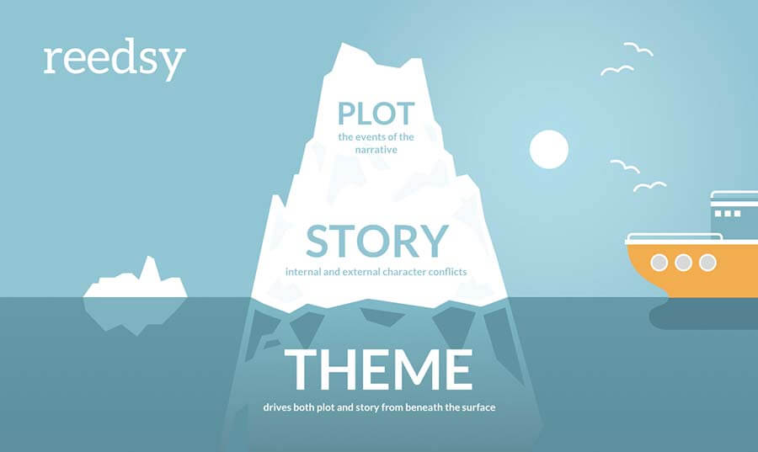
Construct
What is a theme?
The Big Question:
What is a theme?
Key Vocabulary:
Theme
Friendship
Jamie
Pitcher
Love
Family
Grief
Loss
Racism
Bullying
An idea that recurs in or pervades a work of art or literature.
Common themes include: Love, Friendship, Grief, Family…

Slide 5
Construct
For each example, note down what a theme could be.
The Big Question:
What is a theme?
Key Vocabulary:
Theme
Friendship
Jamie
Pitcher
Love
Family
Grief
Loss
Racism
Bullying
Common themes: Love, Friendship, Grief, Family, Guilt, Money, Bravery, Individuality

Slide 6
Construct
For each example, note down what a theme could be.
The Big Question:
What is a theme?
Key Vocabulary:
Theme
Friendship
Jamie
Pitcher
Love
Family
Grief
Loss
Racism
Bullying
Common themes: Love, Friendship, Grief, Family, Guilt, Money, Bravery, Individuality

Slide 7
Construct
For each example, note down what a theme could be.
The Big Question:
What is a theme?
Key Vocabulary:
Theme
Friendship
Jamie
Pitcher
Love
Family
Grief
Loss
Racism
Bullying
Common themes: Love, Friendship, Grief, Family, Guilt, Money, Bravery, Individuality

Slide 8
Apply
One key theme is Family.
The Big Question:
What is a theme?
Key Vocabulary:
Theme
Friendship
Jamie
Pitcher
Love
Family
Grief
Loss
Racism
Bullying
How is Family presented in the story?

Slide 9
Apply and Demonstrate
The Big Question:
What is a theme?
Key Vocabulary:
Theme
Friendship
Jamie
Pitcher
Love
Family
Grief
Loss
Racism
Bullying
Your job for the rest of the lesson:
Note down how each theme is presented and found in the novel.
You can present this in any way you wish: notes, paragraphs, mindmaps, poster.
Themes:
Friendship
Grief/Loss
Bullying
Racism
Mental Health
Challenge:
Can you think of any other themes you could write about?

