Slide 1
Starter Task
List as many characters as you can remember from “My Sister”

Slide 2
Activate
Quick Quiz!
The Big Question:
Who are the main characters of “My Sister”?
Key Vocabulary: Jamie
Character
Novel
Quiz
Extracts
Characterisation
Personality
Appearance
Relationships
Where is the story set?
Who wrote the book?
What is Mum’s job?
What religion in Sunya?
What is the term for being racist towards this religion?
What is the name of Jas’ boyfriend?

Slide 3
Activate
Quick Quiz!
The Big Question:
Who are the main characters of “My Sister”?
Key Vocabulary: Jamie
Character
Novel
Quiz
Extracts
Characterisation
Personality
Appearance
Relationships
Where is the story set? Lake District
Who wrote the book? Annabel Pitcher
What is Mum’s job? Art teacher
What religion in Sunya? Muslim/Islam
What is the term for being racist towards this religion? Islamophobia
What is the name of Jas’ boyfriend? Leo

Slide 4
Construct
How could we describe Jamie’s character?
The Big Question:
Who are the main characters of “My Sister”?
Key Vocabulary: Jamie
Character
Novel
Quiz
Extracts
Characterisation
Personality
Appearance
Relationships
Add information that you already know about Jamie.
Consider:
Age
Hobbies
Friends
Jamie

Slide 5
Construct
On each slide, there will be a small extract.
What information could you add to your character profile?
The Big Question:
Who are the main characters of “My Sister”?
Key Vocabulary: Jamie
Character
Novel
Quiz
Extracts
Characterisation
Personality
Appearance
Relationships
Her fingers touched the Spider-Man t-shirt. I’m a superhero I said. I fight crime. She sighed and it smelled of cola bottles. Through the holes in the blanket I could see her shiny shiny eyes and they were brighter than all the stars in the sky. Why do you really wear it she said. She drew her legs to her chest and rested her chin on her kneecap. She was sucking a lollipop really slowly like she had all the time in the world to hear my story. I tried to speak, but nothing happened.
When we left London, Dad spent about an hour trying to push his wardrobe through the bedroom door. He turned it on its side. He tried it upside down. He tilted it one way and then the other but it just would not fit. Words like Mum and Affair and Dad and Drinking were just like that wardrobe – too big to get out. No matter what I did, I couldn’t fit them through the space between my teeth.

Slide 6
Construct
On each slide, there will be a small extract.
What information could you add to your character profile?
The Big Question:
Who are the main characters of “My Sister”?
Key Vocabulary: Jamie
Character
Novel
Quiz
Extracts
Characterisation
Personality
Appearance
Relationships
We ate our cereal in front of the TV and a lady with the same skin colour as Sunya read out the news. Dad said Bloody P*ki on the BBC like it was a bad thing. She might not be from Pakistan I replied, before I could stop myself. Jas’s eyebrows disappeared beneath her pink fringe. Dad switched channel. A cartoon came on. What did you say. His voice was calm but his knuckles went white as he squeezed the remote. I coughed. What did you say, James. Jas pulled a finger across her lips, telling me to shut up. Even though she wasn’t wearing her white make-up, her face had gone pale. Nothing I said. Dad nodded. Thought not he said and he gave the urn a little nod.

Slide 7
Construct
On each slide, there will be a small extract.
What information could you add to your character profile?
The Big Question:
Who are the main characters of “My Sister”?
Key Vocabulary: Jamie
Character
Novel
Quiz
Extracts
Characterisation
Personality
Appearance
Relationships
There was a splash. I knelt down and bent over until my nose touched the black water. Somewhere among the floaty plants and swirling weeds, I knew there was a goldfish. Its silky skin is the exact same colour as my hair and I used the same orange pencil to draw us both in my sketchbook. All the times that I’ve looked in the pond, I’ve never seen any other creatures. The fish is alone. I know exactly how it feels.

Slide 8
Construct
On each slide, there will be a small extract.
What information could you add to your character profile?
The Big Question:
Who are the main characters of “My Sister”?
Key Vocabulary: Jamie
Character
Novel
Quiz
Extracts
Characterisation
Personality
Appearance
Relationships
Jas got home and found me leaning on the kitchen wall by the phone. I tried to make it look natural, like it was just dead comfortable to have the back of my head pressed against the hard wall, but she didn’t buy it. What’s going on she asked and I blurted everything out. She frowned when I told her about Daniel, but she laughed when I said I’d shouted Men don’t wear daisy chains. It felt nice that she was proud of me, even though it was a lie.

Slide 9
Construct
Pitcher focuses on Jamie’s family and his personality.
What did we learn about Jamie in the extracts?
The Big Question:
Who are the main characters of “My Sister”?
Key Vocabulary: Jamie
Character
Novel
Quiz
Extracts
Characterisation
Personality
Appearance
Relationships

Slide 10
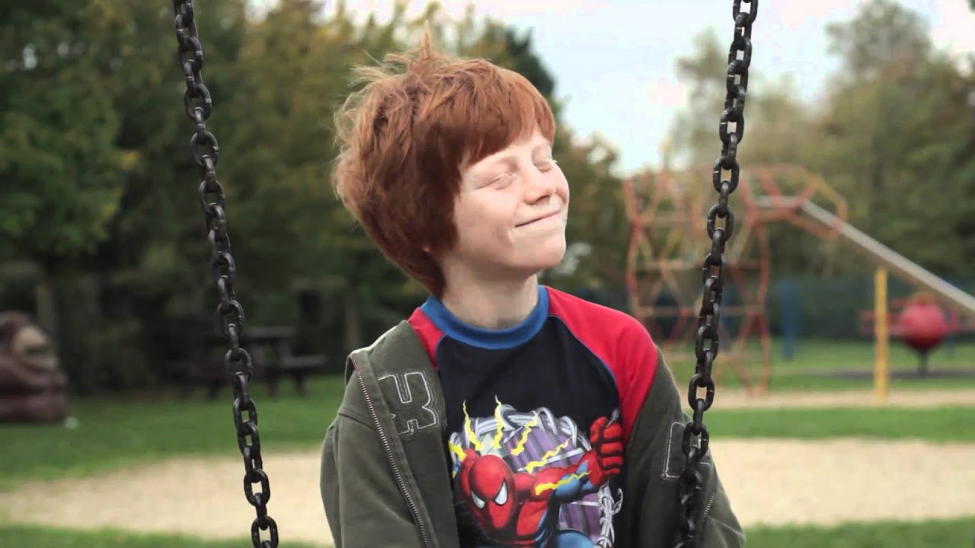
Apply
5 minutes – sum up Jamie’s character in a paragraph!
The Big Question:
Who are the main characters of “My Sister”?
Key Vocabulary: Jamie
Character
Novel
Quiz
Extracts
Characterisation
Personality
Appearance
Relationships
Challenge: Consider WHY Pitcher is choosing to present Jamie in this way.

Slide 11
Extension
Create a detailed character profile for a character of your choice!
The Big Question:
Who are the main characters of “My Sister”?
Key Vocabulary: Jamie
Character
Novel
Quiz
Extracts
Characterisation
Personality
Appearance
Relationships
You will need to think about:
Appearance
Relationships
Personality
Use this link to help you!
https://booksvooks.com/fullbook/my-sister-lives-on-the-mantelpiece-pdf.html?page=11

